Slide 1
Elective Recommendation System
PIP2001 Capstone Project
Review-0
Batch Number: ISR-G04
Roll Number | Student Name
20211ISR0027 | P.DURGA MARUTHI VARA PRASAD ( group leader)
20211ISR0005 | ALLEN SAJI
20211ISR0091 | FAIZAN NIZAMUDDIN
20211ISR0015 | SYED YUSUF HUSSAIN
20211ISR0065 | S NAYMAAN KHAN
Under the Supervision of,
Dr.Swati Sharma
School of Computer Science and Engineering
Presidency University
Name of the Program: Information Science And Engineering AI & Robotics
Name of the HoD: Dr.Zafar Ali Khan N
Name of the Program Project Coordinator: Dr.Swati Sharma
Name of the School Project Coordinators: Dr. Sampath A K / Dr. Abdul Khadar A / Mr. Md Ziaur Rahman

Slide 2
Content
Problem Statement
Github Link
Analysis of Problem Statement
Timeline of the Project
References

Slide 3
Problem Statement Number:
Organization:
Category (Hardware / Software / Both) : software
Problem Description: One of the challenges (or complaints) from students at Presidency University is that they are either unable to get the subjects of their choice, as well as, when they get their electives, they realize that their friends are not with them, leading to a lot of confusion. Similarly, there are a number of students who do not get the electives of their choice, and are arbitrarily assigned electives by their corresponding HoD or the timetable committee to try to achieve a balanced distribution of students among the different discipline electives. In this project, students are to develop a system that can aid their fellow students at Presidency University in choosing their different discipline and open electives, by recommending electives to the students and HoDs.
Difficulty Level: complicated

Slide 4
Github Link
The Github link provided should have public access permission.
Github Link:
created by the group leader :
https://github.com/durgamaruthi/ELECTIVE_RECOMMENDATION_SYSTEM.git

Slide 5
Analysis of Problem Statement
Technology Stack Components:
1. Frontend/UI Layer
Gradio:
To build an interactive web-based interface for students and HoDs to interact with the recommendation system.
Gradio simplifies UI creation for machine learning models and allows users to interact with your model in real-time, without needing frontend development skills.
Directly integrates with machine learning models and can be hosted locally or deployed on cloud platforms.
2. ML Models
Hugging Face Transformers:
To utilize pre-trained models for recommendation systems.
Hugging Face provides pre-trained models that can be fine-tuned for specific NLP tasks, allowing efficient processing of course descriptions, student reviews, and feedback for content-based recommendations.
Works with PyTorch or TensorFlow to train or fine-tune models.

Slide 6
Analysis of Problem Statement
Collaborative Filtering Algorithms (e.g., Matrix Factorization (SVD), ALS):
To generate elective recommendations by finding similarities between students based on their elective choices.
Collaborative filtering helps identify hidden patterns in student enrollment behavior and peer influence.
Can be implemented using scikit-learn or implicit libraries.
Use Alternating Least Squares (ALS) or SVD for collaborative filtering.
Data Processing & Feature Engineering
Pandas/Numpy:
To manipulate and process datasets related to students, courses, enrollment history, and feedback.
These libraries offer essential data manipulation tools for feature extraction, cleaning, and preparing data for model training.
Used in conjunction with Hugging Face for data preprocessing.
NLTK/Spacy:
For text preprocessing in content-based filtering (e.g., tokenization, lemmatization, named entity recognition).
Used to prepare course descriptions and student feedback for the recommendation model.
Pairs with NLP models to improve recommendation relevance.

Slide 7
Analysis of Problem Statement
Model Training & Deployment
PyTorch:
To implement and fine-tune deep learning models, such as BERT variants, for content-based filtering.
PyTorch’s dynamic computation graph and widespread integration with Hugging Face make it ideal for building recommendation systems.
Works seamlessly with Hugging Face Transformers for model training.
scikit-learn:
For implementing traditional ML algorithms like K-means clustering, SVD, or logistic regressionfor recommendation systems.
Simple, fast, and efficient for handling collaborative filtering models or clustering-based recommendations.
Pairs with the backend for hybrid models.
Data Storage
Deployment & Scaling

Slide 8
Analysis of Problem Statement (contd...)
Software and Hardware Requirements
Software Requirements:
Operating System: (macOS).
Python: Version 3.12.4
Libraries:
Gradio
Hugging Face Transformers
scikit-learn
PyTorch
Pandas, Numpy
NLTK or Spacy (for text preprocessing)

Slide 9
Analysis of Problem Statement (contd...)
Hardware Requirements:
CPU/GPU:
CPU: allen laptop configuration
GPU : allen laptop configuration
Memory:
Development: 16GB RAM for small-scale development.
Production:
Storage:
Development: 50GB for storing datasets, models, and logs.
Production: Cloud storage for scalability .

Slide 10
Analysis of Problem Statement (contd...)
At Presidency University, students face two major challenges in the elective selection process:
Unorganized Elective Recommendations: Students struggle to receive their preferred electives because the current system does not tailor recommendations based on their department, interests, or academic performance. This leads to confusion and dissatisfaction when students either don’t get their desired subjects or are placed in electives that are not well-suited to them.
Inefficient Distribution of Students in Electives: HoDs are responsible for ensuring balanced student distribution across electives. Currently, this process is arbitrary, with HoDs often forced to assign students randomly. There is no mechanism to ensure that enough students are distributed across all electives, while avoiding overcrowding in popular courses.

Slide 11
Analysis of Problem Statement (contd...)
The proposed Elective Recommendation System will solve these problems by offering a recommendation engine for both students and HoDs. For students, the system will recommend electives based on their academic profiles, preferences, and departmental needs. For HoDs, the system will monitor elective enrollments in real time, ensuring a balanced distribution without manual intervention. If certain electives become overcrowded, the system will dynamically recommend alternatives to students, ensuring optimal distribution.

Slide 12
Analysis of Problem Statement (contd...)
The Elective Recommendation System must solve two interconnected problems:
Student Elective Choice:
Why it’s a problem: The current list of elective options is not personalized for each student. The recommendations are not based on student preferences, academic needs, or the department they belong to. This leads to confusion when students either cannot enroll in their preferred subjects or when they realize their friends are in different classes, which decreases their engagement.
Solution: The system will offer personalized recommendations using AI/ML techniques. It will track the student’s preferences, department, and past academic performance to recommend the best available electives that match their profile. The system will also ensure that students know which electives are available and prevent them from enrolling in full courses.

Slide 13
Analysis of Problem Statement (contd...)
HoD's Monitoring and Distribution:
Why it’s a problem: HoDs currently face challenges in managing student distribution. Without an automated system, they must assign students to electives randomly to achieve balance. This is not only inefficient but can also lead to dissatisfaction among students who feel their preferences were ignored.
Solution: The system will monitor student enrollment in real time and adjust recommendations accordingly. HoDs will be able to oversee the process without having to manually assign students. The system will dynamically redistribute students to ensure that no course is over-enrolled or under-enrolled.

Slide 14
Analysis of Problem Statement (contd...)
Key Features:
Dynamic Recommendations: If certain electives become full, the system will re-suggest electives to students based on their preferences, ensuring that they still find suitable alternatives.
Continuous Monitoring: HoDs can monitor the distribution of students across electives without needing to intervene manually. The system will balance enrollments automatically, allowing them to focus on monitoring rather than manual decision-making.
Student Notification: Students will be notified of available electives and prevented from enrolling in overcrowded courses, minimizing unnecessary conflicts.

Slide 15
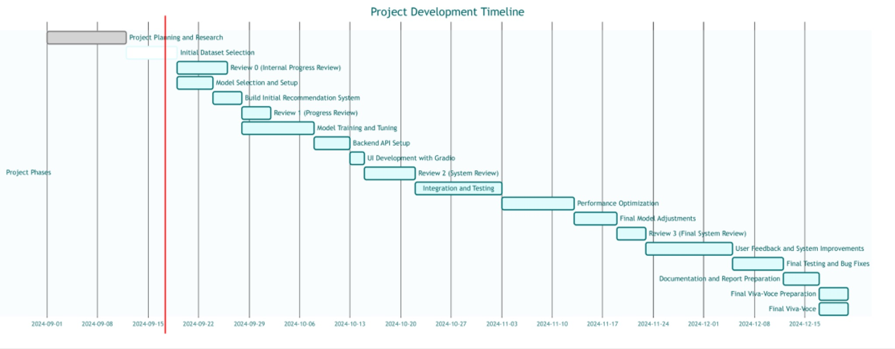
Timeline of the Project (Gantt Chart)

Slide 16
References (IEEE Paper format)
Hugging Face, Inc. (2023). Transformers: State-of-the-art Natural Language Processing for PyTorch and TensorFlow. Hugging Face.
Sedhain, S., Menon, A. K., Sanner, S., & Xie, L. (2015). AutoRec: Autoencoders meet collaborative filtering. Proceedings of the 24th International Conference on World Wide Web, 111–112.
Abdullah, M. A., & Li, H. (2019). A survey of machine learning-based recommender systems for e-learning. IEEE Access, 7, 175990-176002.
Gradio. (2022). Gradio documentation: Easy machine learning interface with Gradio. Gradio.
Ricci, F., Rokach, L., & Shapira, B. (2011). Introduction to recommender systems handbook. Springer.
Luo, C., Li, Y., Zhang, L., & Yao, C. (2020). A hybrid recommendation model for personalized online course selection. 12th International Conference on Education Technology and Computers (ICETC), 28-33.
Nielsen, J. (1994). Heuristic evaluation in user interface design. Proceedings of the ACM CHI 1994 Conference on Human Factors in Computing Systems, 413-414.

Slide 17


